Slide 1
📊 Analytics & Insights Report
Based on Sample Superstore Data
Presented by: Priyanshu Kumar Role: Data Analytics Enthusiast / B.Tech CSE Student Date: 6 August 2025

Slide 2
In this report, we analyze data from a superstore containing details such as customer names, customer IDs, delivery delays (in days), sales by region and various conditions, profits and discounts, sales by segments, and sales-profit figures by category and sub-category.
Using these factors, we aim to generate actionable insights that can guide data-driven decision-making.

Slide 3
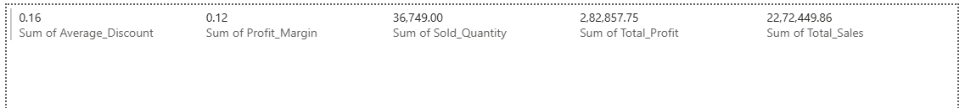
Basic KPI’s of superstore

Slide 4
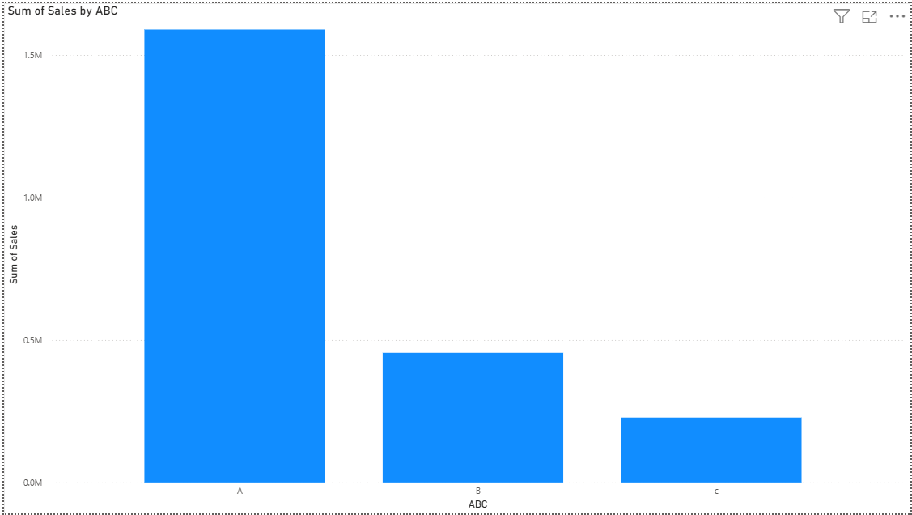
Sales by ABC category
The data reveals the following distribution of sales:
Section A accounts for the top 70% of total sales, amounting to 1,589,759.99 M.
Section B represents the next 20% (70%–90% range) of total sales, totaling 454,939.97 M.
Section C comprises the remaining 10% of total sales, with 227,749.89 M.

Slide 5
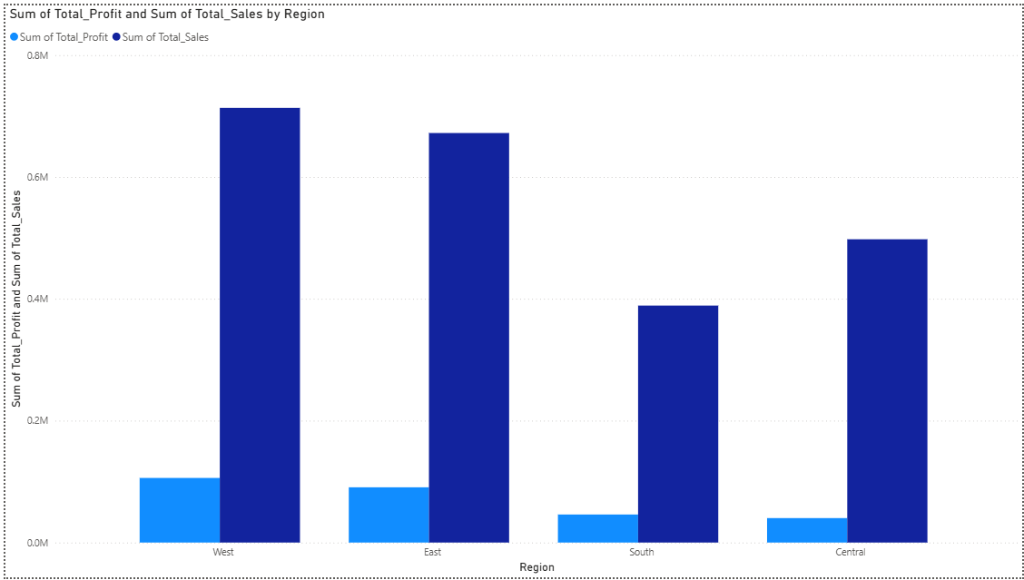
Total profit & Total sales by Region
The Central region records the lowest profits at 40,128.90 M.
The West region achieves the highest profits at 106,021.15 M.
The South region has the lowest sales at 388,983.59 M.
The West region records the highest sales at 713,471.34 M.

Slide 6
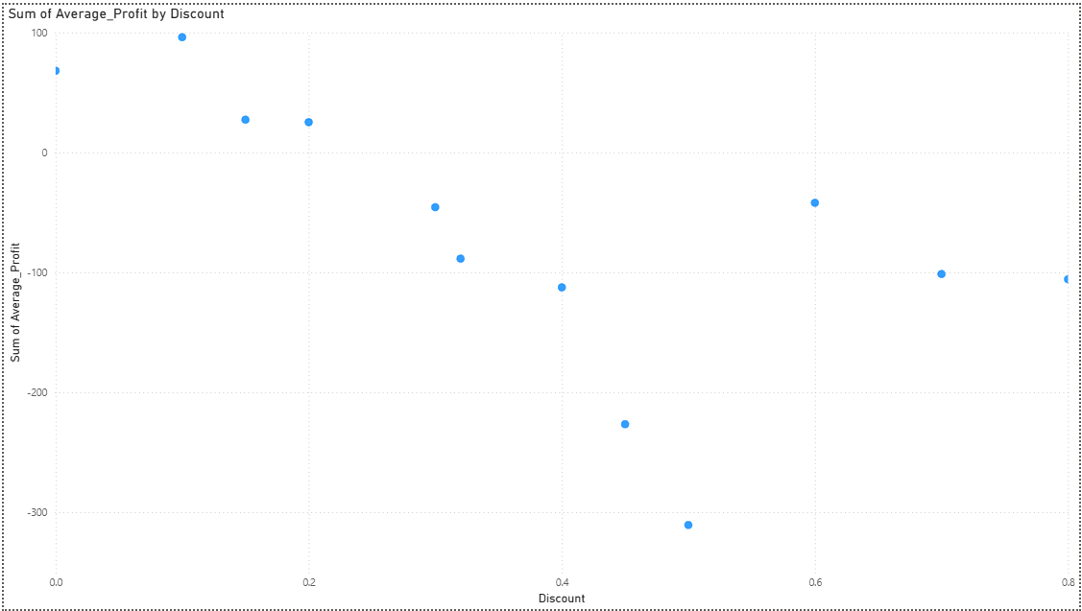
Average profit by Discount
According to the data, discounts in the 0–0.2 range yield positive average profits. However, for discounts above 0.2, the average profit becomes negative, indicating a complete loss.

Slide 7
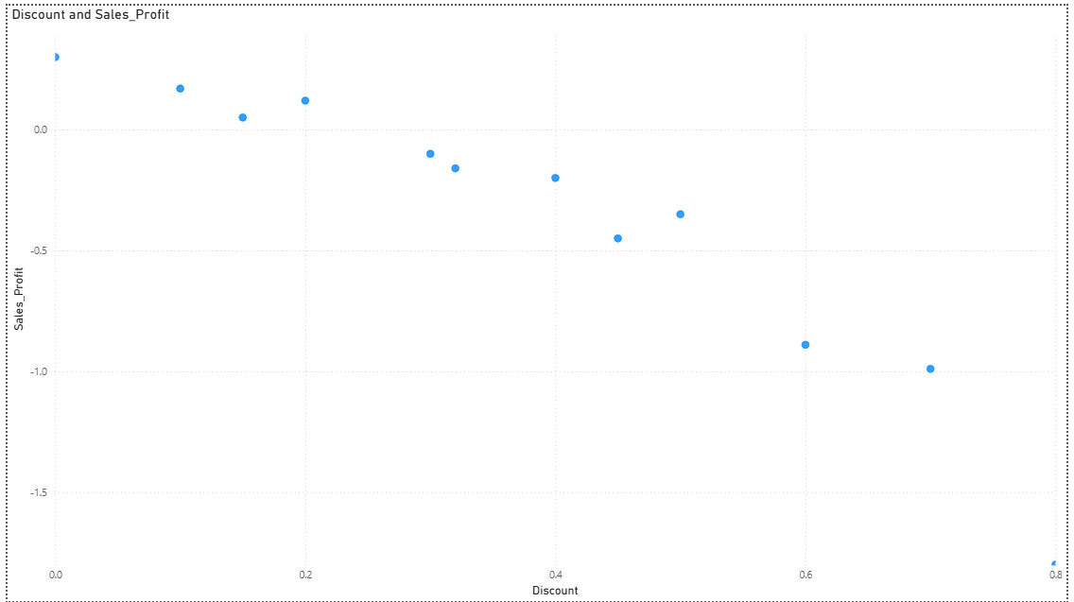
Sales profit by Discount
According to the data, the profit margin remains positive only for discounts between 0 and 0.2. Beyond a 0.2 discount, the profit margin turns negative.
Maximum profit margin: Achieved at 0% discount, with a 30% margin.
Maximum loss: Occurs at 0.80 discount, with a -180% margin.

Slide 8
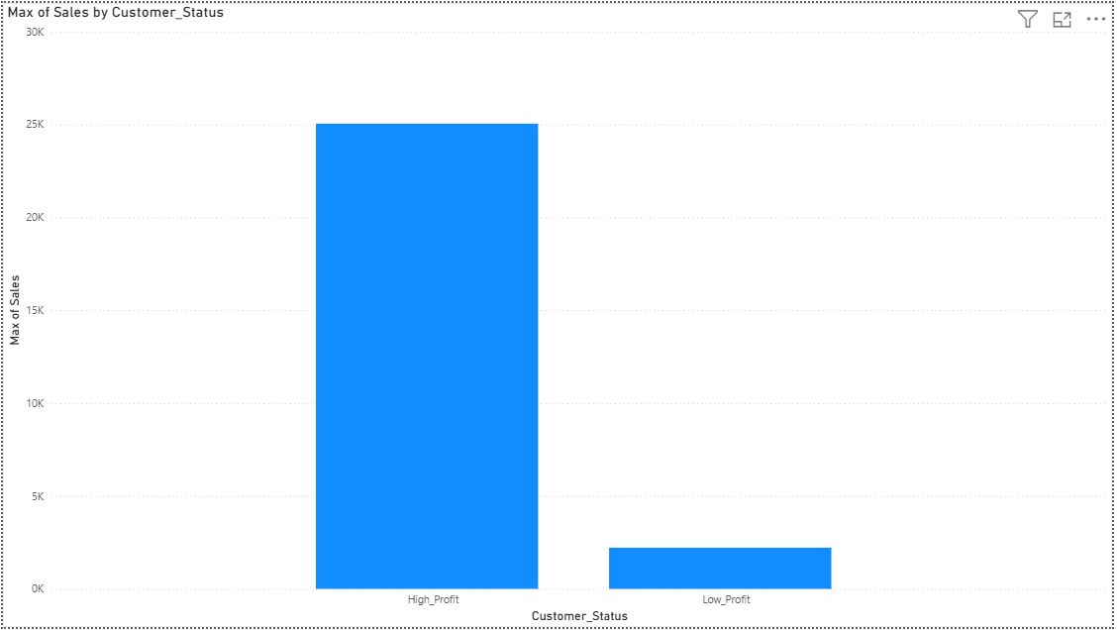
Sales by Customer status
Customers in the high-profit segment achieved the highest sales of 25,000 units, whereas customers in the low-profit segment recorded maximum sales of only 2,200 units.

Slide 9
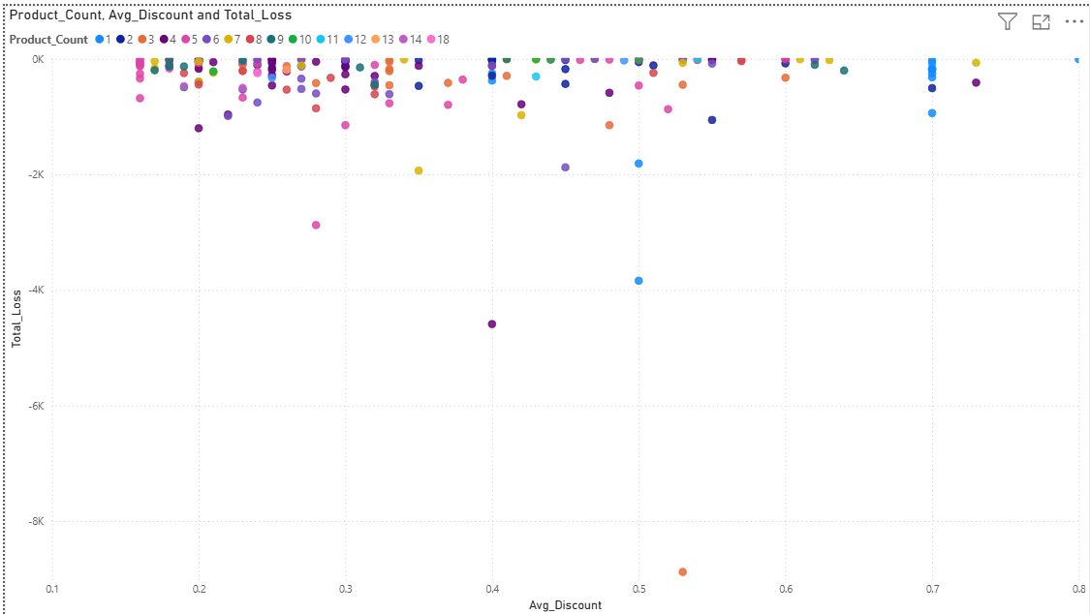
Total Loss by Average Discount
This section records the highest loss count, with 18 products. It highlights products that are both loss-making and have high product counts, along with their corresponding loss amounts.

Slide 10
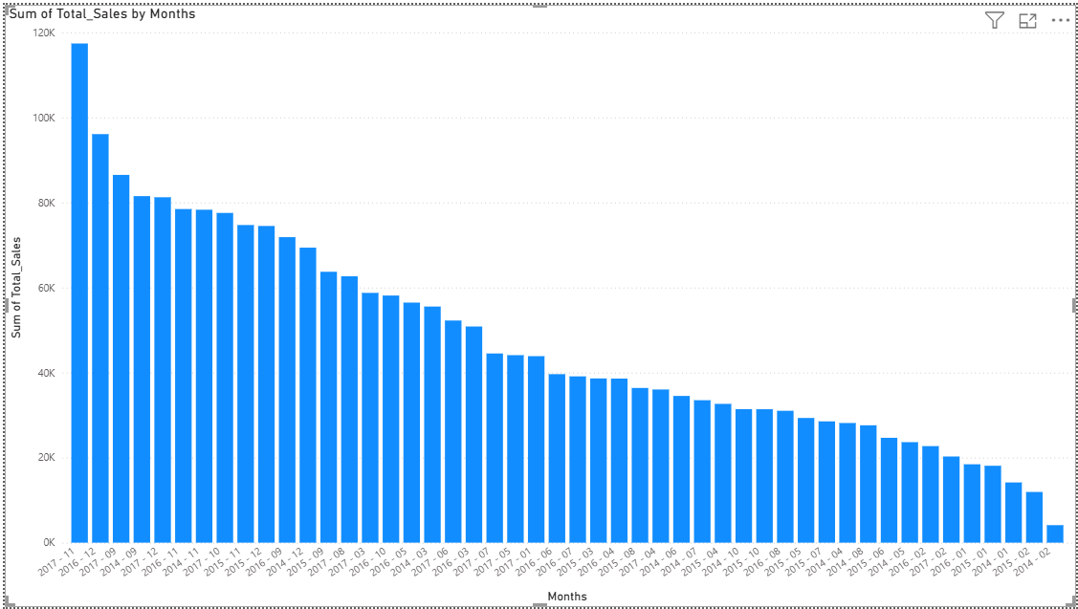
Total Sales by Months
The data shows fluctuations in sales over the years, with both increases and declines.
Highest sales were recorded in November 2017 at 117,383.38 thousand, followed by a decline in December 2017 to 81,227.62 thousand.
Lowest sales occurred in February 2014, at just 4,119.82 thousand, compared to 14,161.35 thousand in January 2014.
Overall, the sales trend experienced periodic growth and decline throughout the observed period.

Slide 11
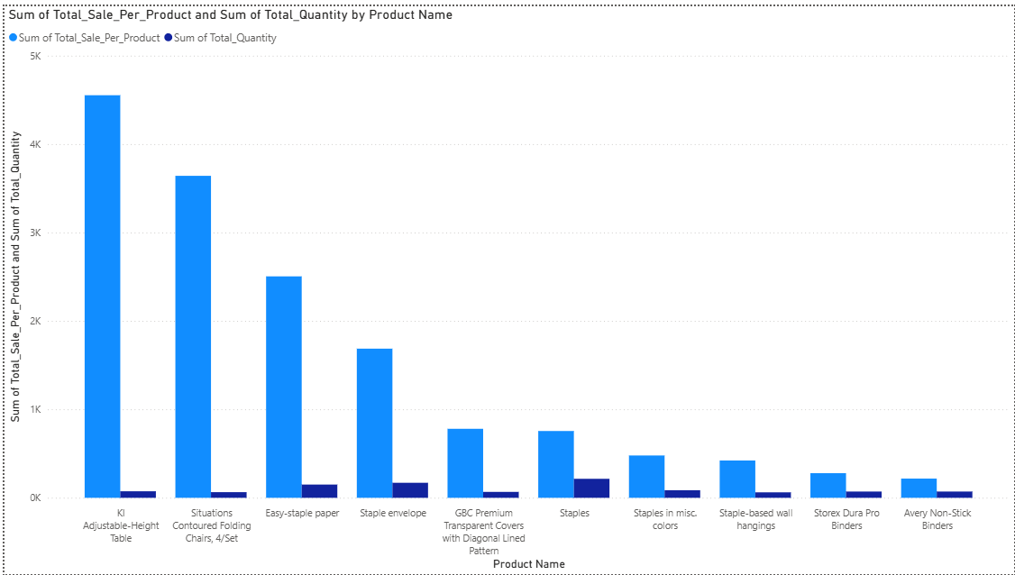
Total Sales per Product & Total Quantity by product Name
Top 10 Most Sold Products
Minimum total sales per product:
Avery Non-Stick Binders –217.32
Maximum total sales per product: KI Adjustable-Height Table – 4,552.64
Minimum total quantity sold: Staple-Based Wall Hangings – 62 units
Maximum total quantity sold: Staples – 215 units

Slide 12
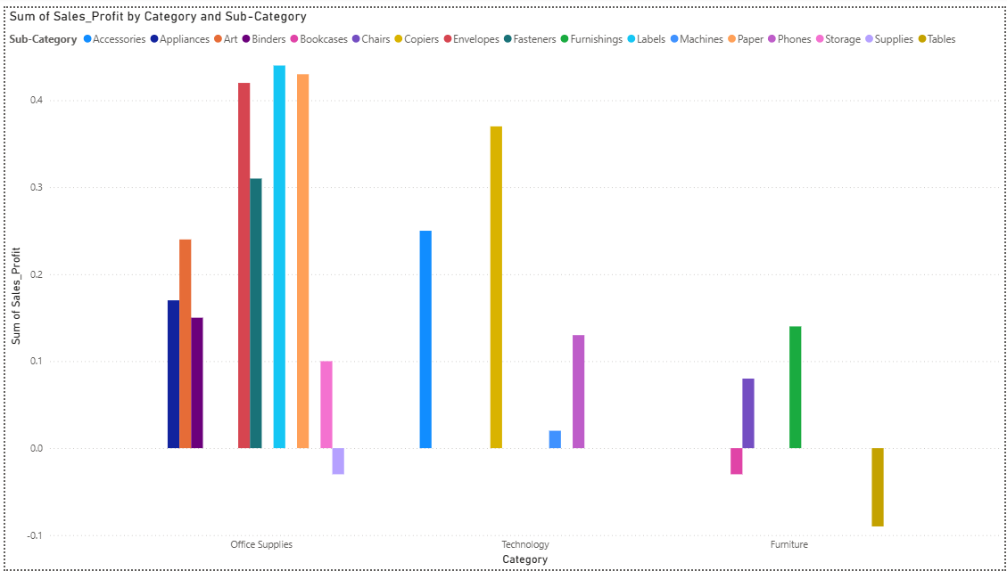
Sales profit by Category and Sub - Category
According to the data, only the Office Supplies and Furniture categories show a negative profit margin.
Within Office Supplies, the Supplies sub-category is in loss.
Within Furniture, Bookcases and Tables are in loss.
The Technology category remains in the safe zone, generating positive profits.

Slide 13
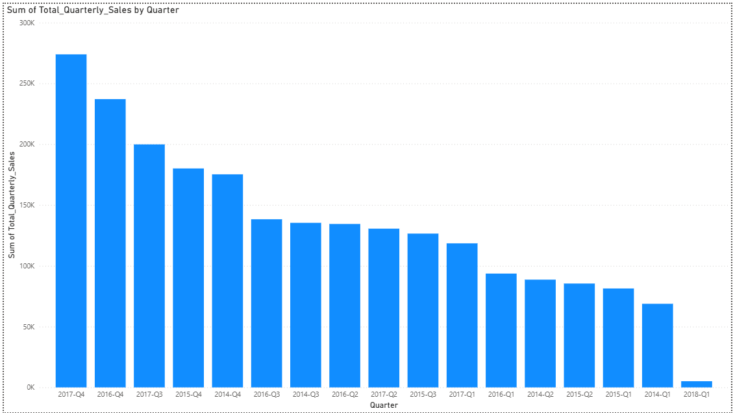
Total Quarterly Sales by Quarters
According to this and previous monthly data:
Highest sales occurred in Q4 2017, totaling 273,881.72.
Lowest sales were in Q1 2018, with only 5,073.97.
Notably, sales in Q1 2014 (68,749.58) were significantly higher than in Q1 2018, despite being the starting period.

Slide 14
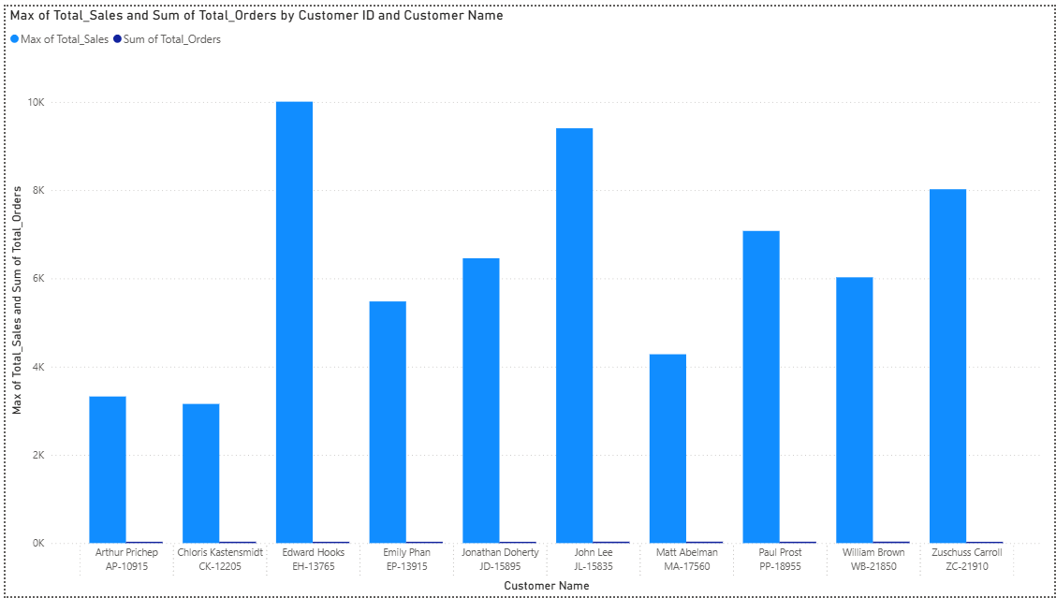
Max. of total sales & total orders by customer id and Name
Top 10 Customers with Maximum Orders
Minimum sales: Customer CK-12205 – 3,154.86
Maximum sales: Customer EH-13765 – 10,005.98
Most orders placed: Customer WB-21850 – 34 orders

Slide 15
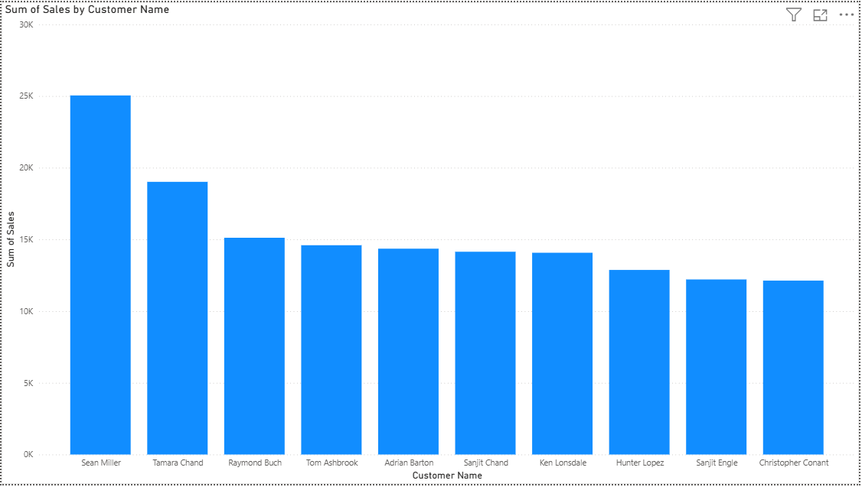
Sales by Top customers
Top 3 Customers by Sales
Sean Miller – 25,043.05
Tamara Chand – 19,017.85
Raymond Buch – 15,117.34
There is a sharp decline in sales from the top customer to the third.

Slide 16
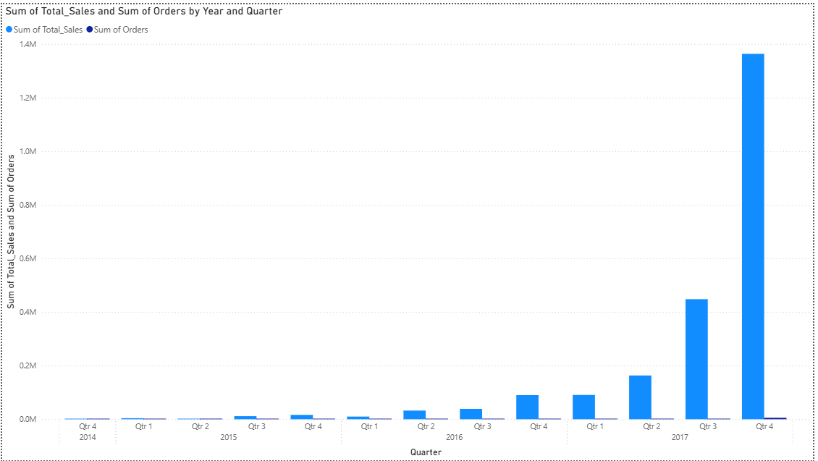
Total sales & orders by Year and Quarter
As per the data, the highest number of orders occurred in Q4 2017, with 5,748 orders and total sales of 1,363,291.38.
Overall, both total sales and order counts have shown an upward trend over the years.

Slide 17
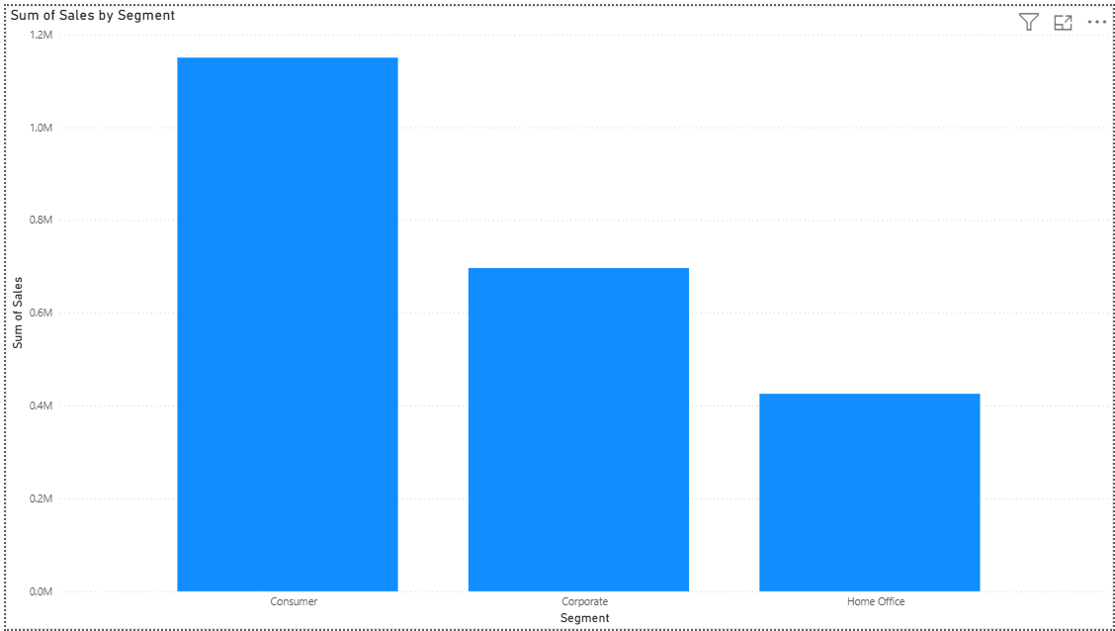
Sales by Segment
According to the data:
Maximum sales: Consumer segment – 1,150,166.15
Second highest: Corporate segment – 696,604.51
Lowest sales: Home Office segment – 425,679.16

Slide 18
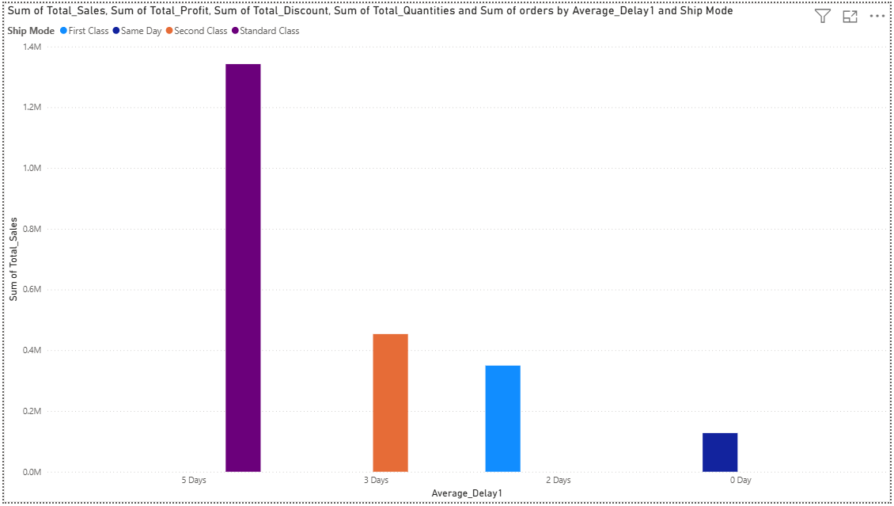
Sales by Average Delay in days
According to the data:
Highest sales occurred when the average delay was 5 days and the ship mode was Standard Class.
Lowest sales occurred with 0 days delay and Same Day shipping.
This indicates that, in this dataset, longer delivery delays are associated with higher sales volumes.

Slide 19
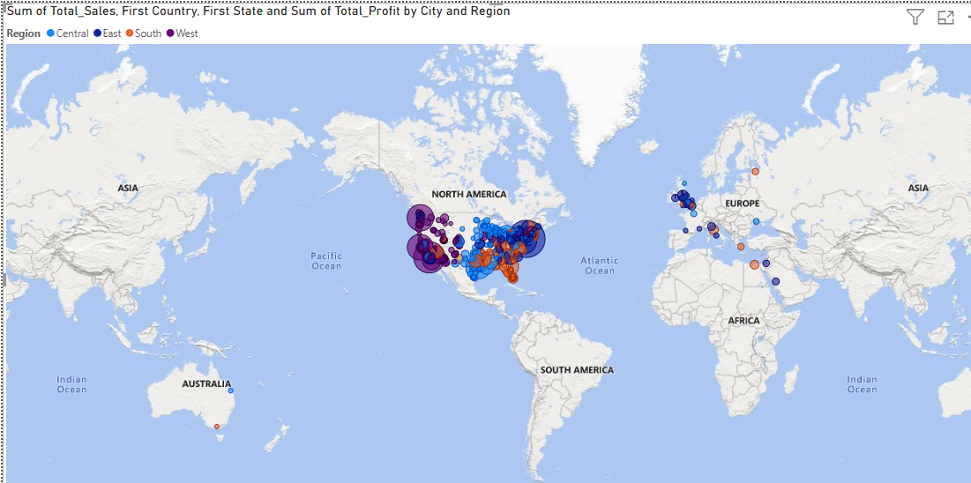
Total sales by Region
According to the data, most sales occurred in this part of the USA.
As observed earlier, the West region recorded the highest sales, while the South region had the lowest sales.

Slide 20
Thank You 🙏
We appreciate your time and attention.
📊 Data speaks louder when we listen to it.
Presented by: Priyanshu Contact: LinkedIn : Priyanshu Kumar
Email : priyanshukumar9053@gmail.com

